Slide 1
Making a hospitable home
Experimental models show:
Millions of CTCs may result in only a handful of metastases
Many micrometastases are non-proliferative/dormant
Cancer cells must re-establish the supportive stroma they left behind:
PDGF and fibroblasts → proliferation
MMPs and myofibroblasts → ECM remodeling
VEGF and Macrophages → angiogenesis
Colonization often initiates near blood vessels

Slide 2
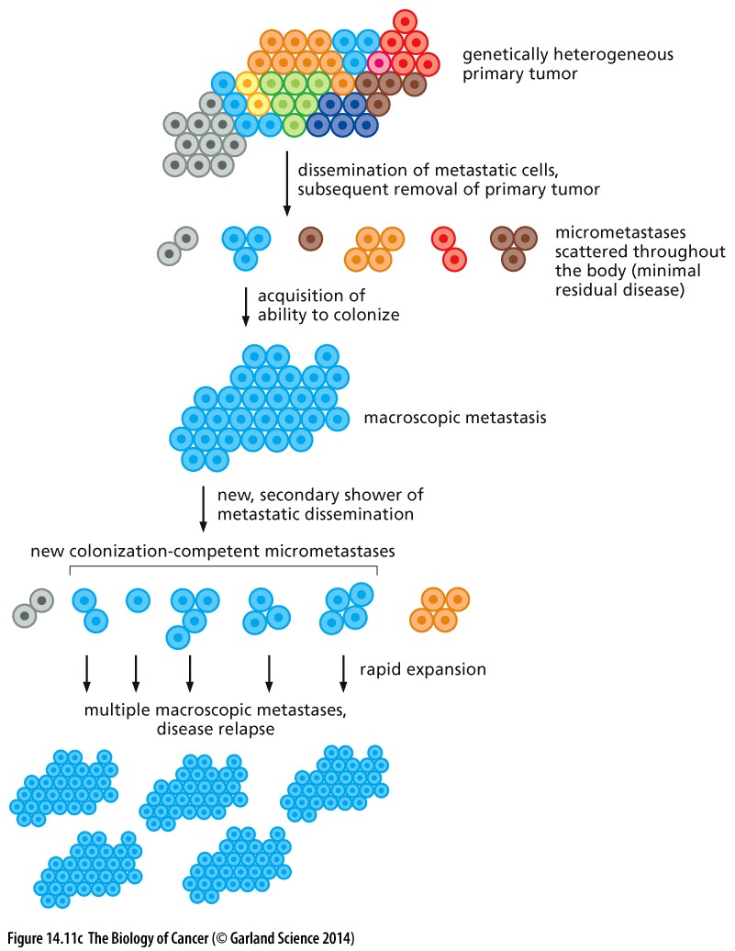
Colonization
Cancer cells continue to acquire mutations
Evolution of a micrometastasis promotes colonization
can give rise to new CTCs that will be much more efficient at colonizing and forming secondary tumors
Acquisition of ability to colonize is tied to proliferation. WHY?

Slide 3
Lecture 17 objectives
Chapter 12
Be able to provide examples of why cancer may or may not derive from stem cells
Be able to describe several features of stem cells and their environment that limit their acquisition of mutations
Be able to provide several examples of how DNA damage can occur in cells and how cells safeguard against such damage

Slide 4
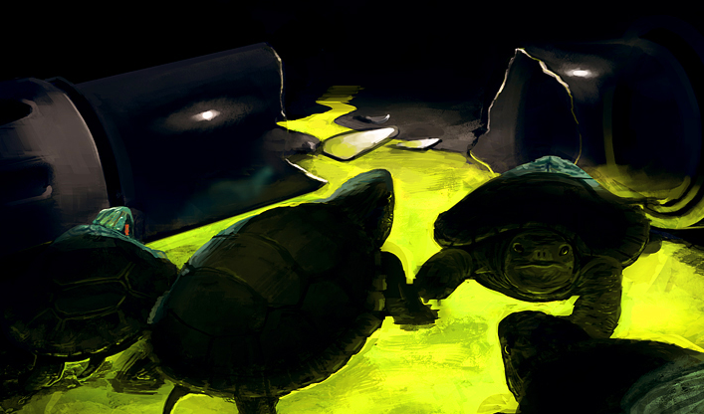
Maintenance of Genomic Integrity is key to cancer prevention
The unlikeliness of a human cell acquiring random mutations in just the right cancer genes to promote tumorigenesis suggests cancer should be exceedingly rare
Yet in the developed world 1:5 people die of cancer
How can we explain this apparent contradiction?
Mutator phenotype: genetic (or epigenetic) changes that permit an increased mutation rate

Slide 5
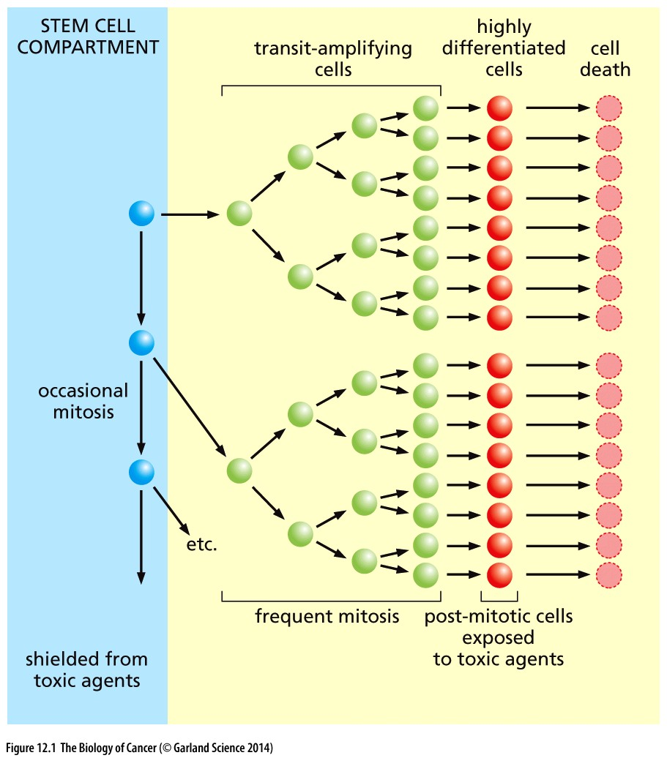
Tissue organization limits accumulation of mutations
Stem cells are the keepers of the genome: tissue organization and proliferation patterns protect them
Stem cells rarely divide
Transit amplifying cells do the bulk of the proliferation
Differentiated cells are exposed to toxic environments

Slide 6
Tissue organization limits accumulation of mutations
Most likely to acquire mutations
Unlikely to impact the tissue:
have a finite lifespan of days or months
Any mutations they acquire die with them

Slide 7
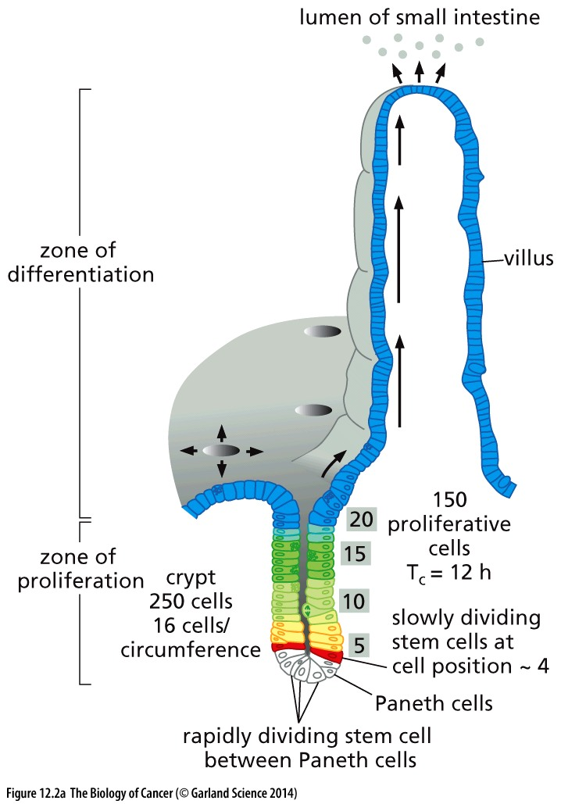
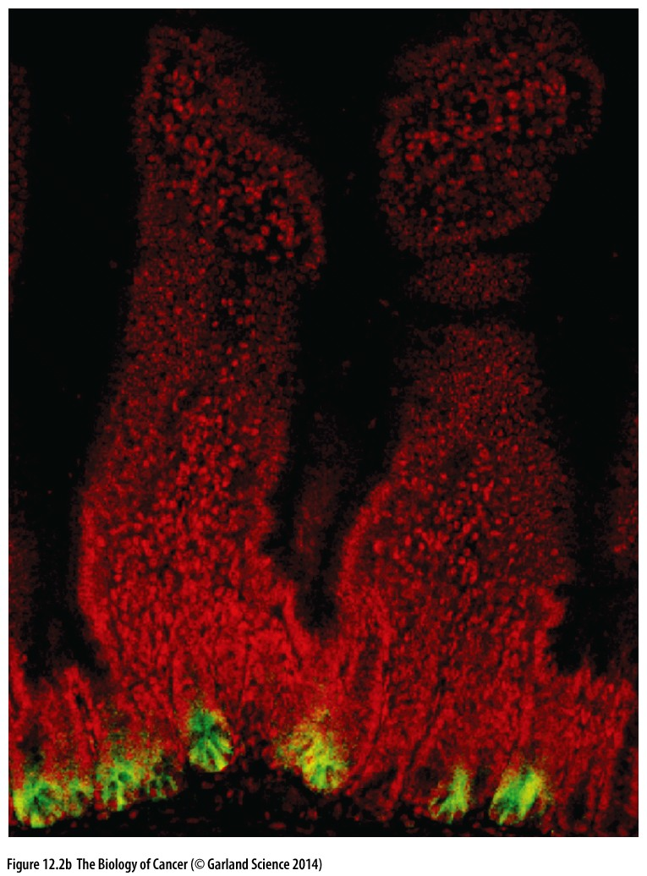
Anatomically shielding designed to protect stem cells
villi of the mouse small intestine
Stem cells are often protected from external assaults
Differentiated cells provide a physical barrier and secrete a thick layer of mucus to block contents of the intestine

Slide 8
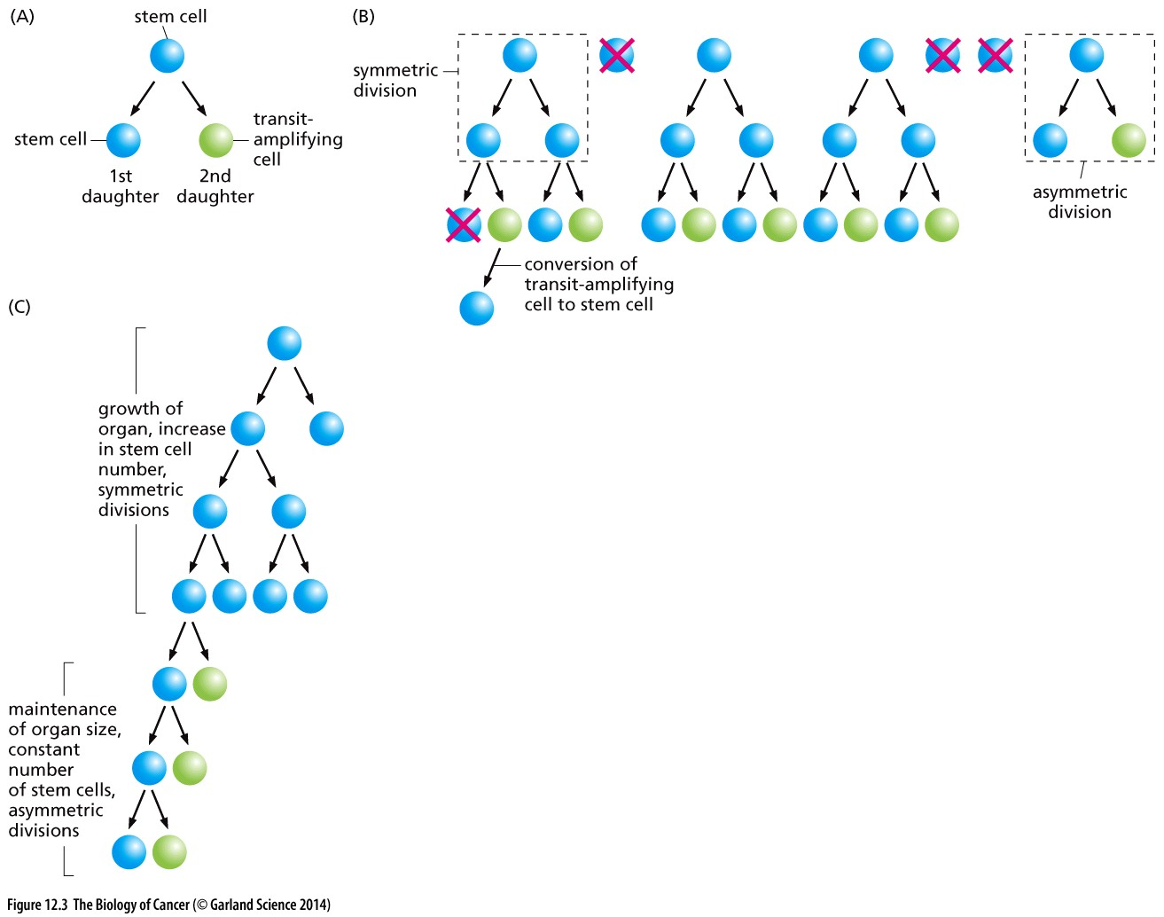
Sensitive stages and sensitive ages
Asymmetric
division
Asymmetric divisions maintain stem cell number
Maintenance of organ size/cell turnover
Symmetric divisions expand stem cell number
Growth of an organ during development or after injury
Symmetric
division
May represent a time when stem cells are more susceptible to mutations?

Slide 9
The true cancer progenitor cells remain unclear
Blocked differentiation is common in hematopoietic malignancies
Cancer initiator steps can be remembered for years before a cancer promoter permits carcinoma formation
→ cells must have a long lifespan to ‘remember’ initiator steps
Self renewing cells are the target of cancer-causing mutagenesis
Stem cells?
Pro: self renewing: can maintain genetic changes
Con: #s and # of divisions are exceedingly low
Progenitor cells?
Pro: far more of them and more proliferative
Con: must de-differentiate to become a stem cell

Slide 10
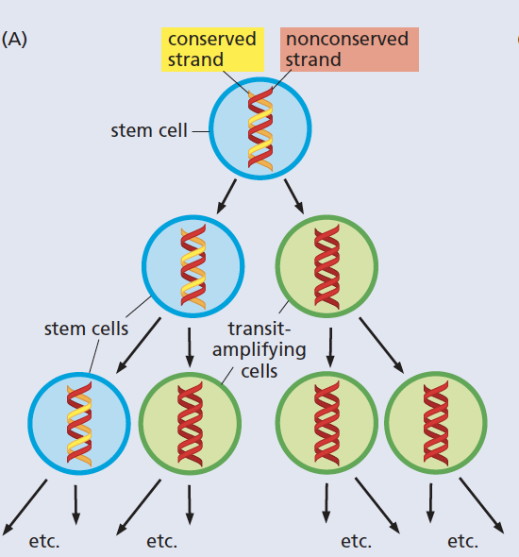
Mechanisms to defend against mutation in stem cells
Anatomical shielding
Limited proliferation
Intestinal stem cells are primed to activate apoptosis in response to DNA damage
Stem cells in other tissues may have super-effective repair mechanisms
Enhances cellular pump activity protect against mutagenic compounds
Asymmetric DNA strand allocation
The ‘old’ strand is maintained in the stem daughter
?

Slide 11
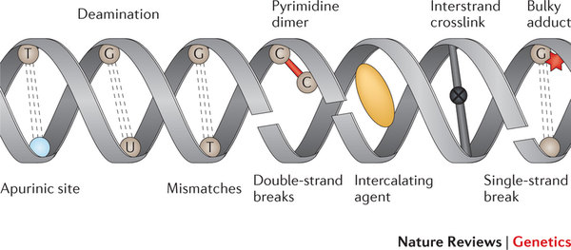
Common types of DNA damage
Caused by both endogenous and exogenous sources
Mismatch errors during replication 1:10,000,000
2 of the more common: deamination and depurination
N-glycosidic bond that attaches the base to the sugar of a nucleotide is easily broken
Occurs with 100,000 bases per cell per day!

Slide 12
Replication error repair is critical
Cytotoxic agents & other tissue damage can kill cells (stem cells too) and necessitate replenishing symmetric stem cell divisions
Exposure to mutagenic agents can alter DNA
Cellular metabolites can damage DNA
Mutations are accumulated during replication

Slide 13
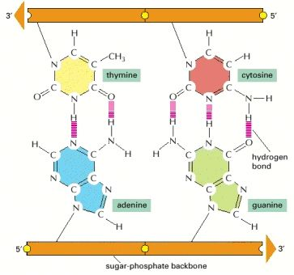
DNA polymerase is the first line of defense against replication-induced mutations
proofreading mechanisms allow DNA polymerase to sense improper base pairs
Proper base pairs enforce
a set distance between the backbones of the helix
A set angle between the base and the sugar
Improper base pairs contort the geometry of the double strand → polymerase can feel this

Slide 14
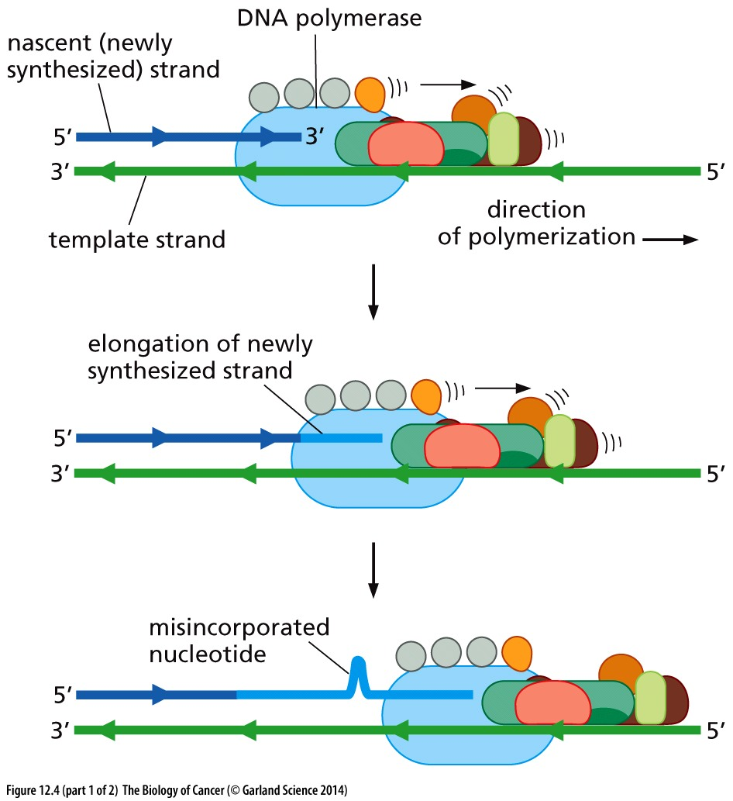
Incorporation of a mismatched base initiates repair pathways

Slide 15
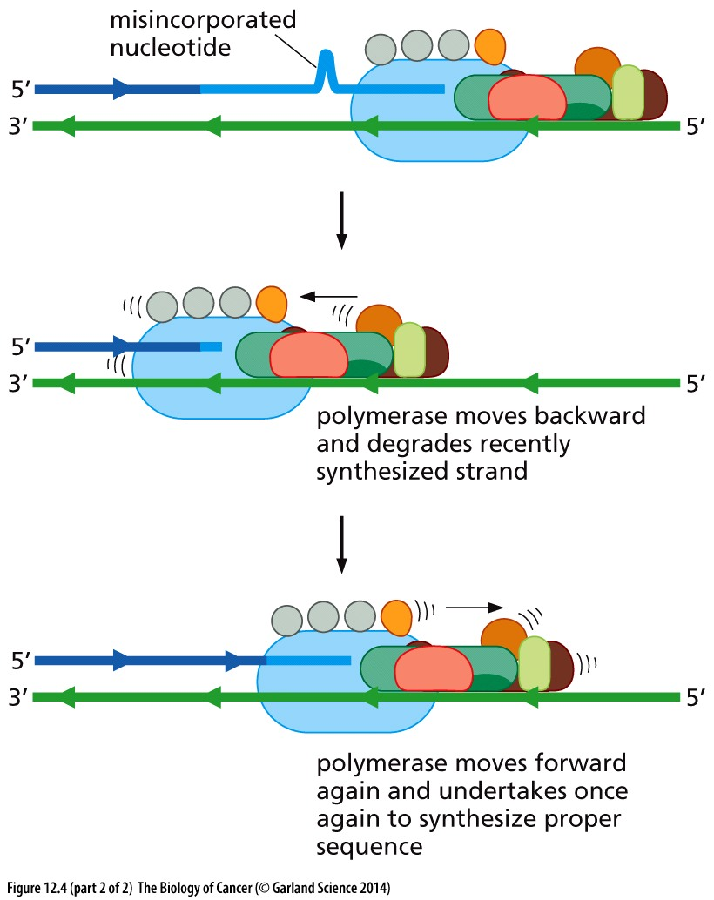
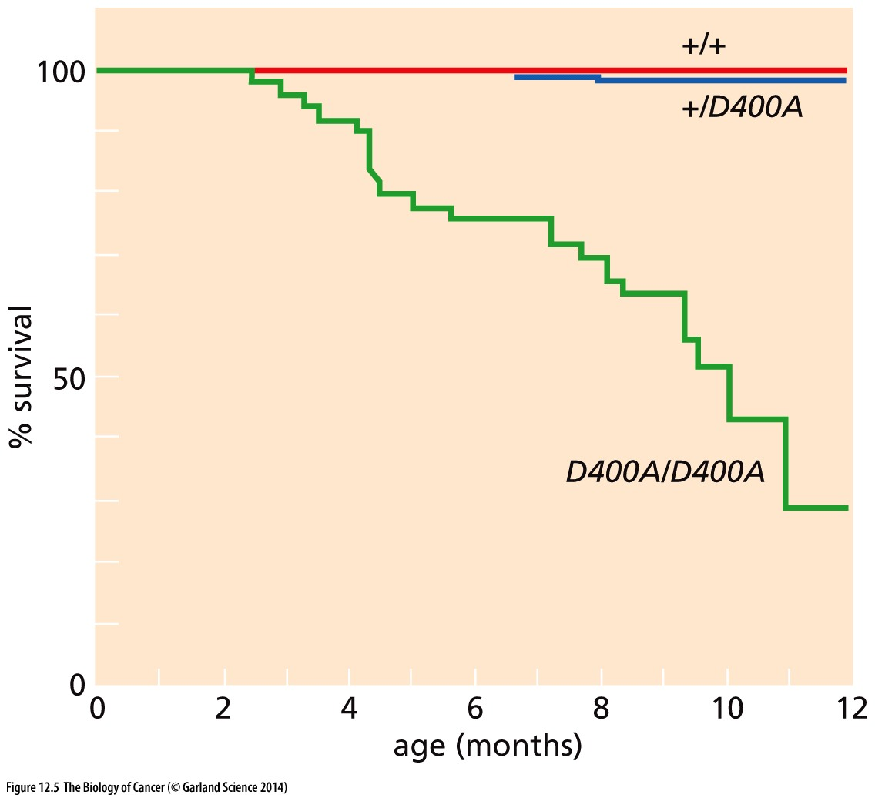
Exonuclease activity of the polymerase allows removal of the improper base
(incorrect base is now 1 in 10⁷)
Mutated polymerase that lacks proofreading function leads to cancer

Slide 16
Mismatch repair proteins double check polymerase’s work
Polymerase can ‘stutter’ on repetitive sequence, leading to unpaired bases
Satellite repeats (>100 nucleotides)
Microsatellite repeats (<100 nucleotides)
MMR proteins detect gaps in DNA sequence that result from these unpaired bases
Does it matter WHICH strand is repaired?

Slide 17
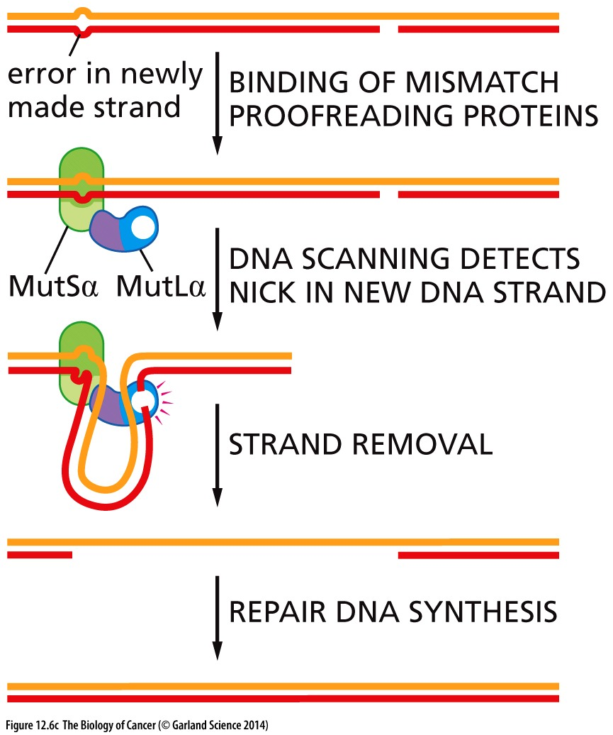
Selective repair of the ‘new’ strand
Repair of the template strand would permanently introduce a genetic change in BOTH strands
Incorrect base is now 1: 10⁹
Defects in MMR machinery lead to microsatellite instability (MIN)

Slide 18
Non-replicative mutagenic mechanisms of endogenous origin
aka: cellular metabolites can alter DNA structure and sequence
Depurination & depyrimidination removes a base
Deamination changes a base (removal of an amine group)
Double strand nature of DNA is protective, even so…
Both can happen in non-proliferating cells
Change in the genomic sequence may impact RNA translation
WILL induce permanent genomic changes if not repaired before next round of replication

Slide 19
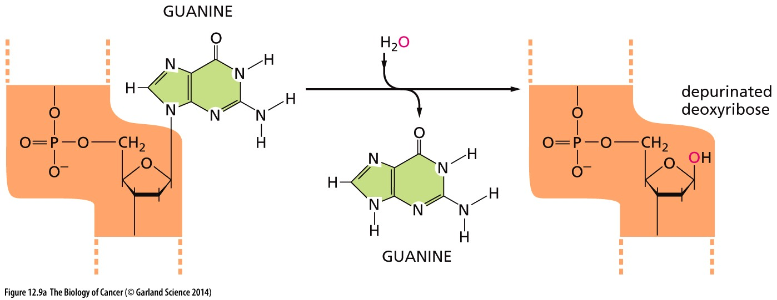
Non-replicative mutagenic mechanisms of endogenous origin
Depurination/depyrimidination removes a base from the sugar backbone
→ up to 10¹⁷ bases lost per day/per cell
Doesn’t depend on replication to occur
But has major consequences for the genome when the damaged strand is replicated

Slide 20
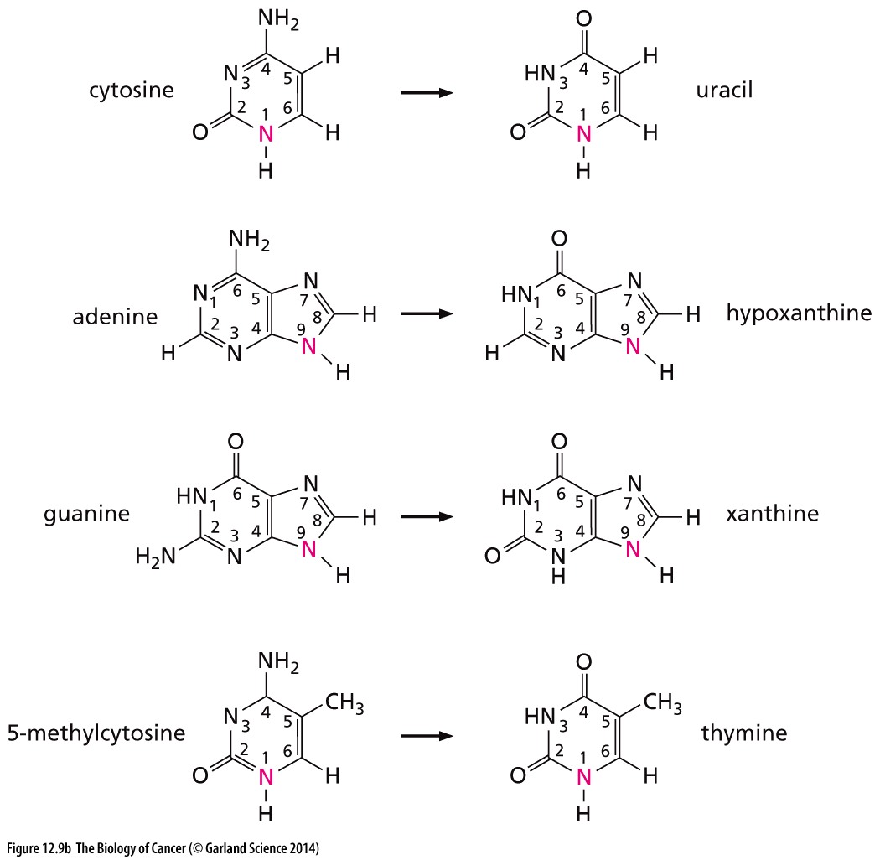
Non-replicative mutagenic mechanisms of endogenous origin
Deamination and oxygenation changes a base
Guanine:
:Adenine
→ Aberrant bases may result in new base-pairs during next round of replication

Slide 21
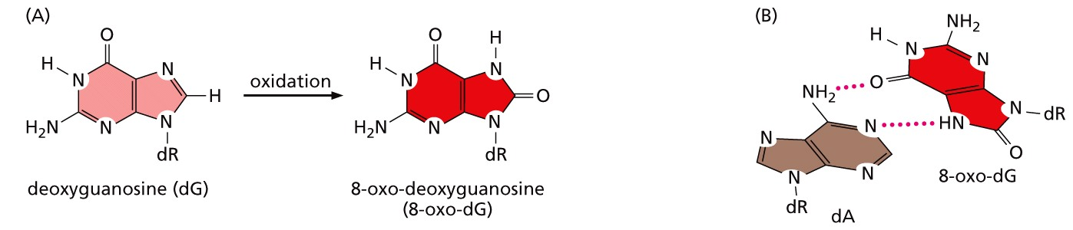
Metabolic intermediates of O₂ reduction represent a major danger to DNA integrity
Reactive oxygen species (ROS): Intermediates are highly reactive and form covalent bonds to other molecules- DNA included
Can induce:
Altered and abasic sites
single and double strand breaks
DNA-protein crosslinks
Result in new base pairs and DNA sequence changes during replication
ROS scavengers (vitamins C & E) chemically react with ROS to neutralize

Slide 22
Chemical defense against damage
Gluytathione S-transferase enzymes (GSTs) link glutathione to carcinogens (that are electrophilic)→ metabolism and excretion
GST expression is dramatically suppressed in many cancer contexts → increased rate of mutagenesis

Slide 23
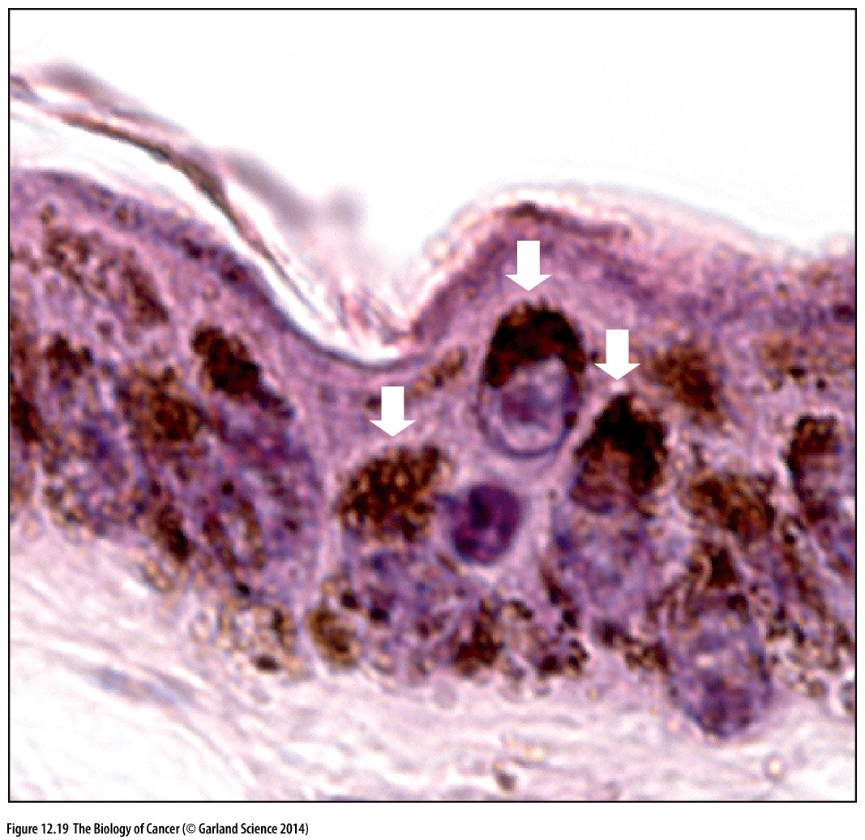
Cells actively protect against mutagen attack
Melanin → pigment shields against UV damage
Expressed by melanocytes
positioned where it can best protect the nuclear DNA
>4-fold decrease in UV damage
No similar protection exists for X rays or cosmic rays

